Slide 1
ANALYSIS OF DEATH BY RISK FACTORS
DATA 230 DATA VISUALIZATION
Presented by: Shripal Shah (014633411)
Presented to: Andrew H. Bond

Slide 2

AGENDA
Introduction
Objective
Dataset
Methodology
Analysis
Source: Link
Results
Inference

Slide 3
INTRODUCTION
During the pandemic, we have realized how important life is and how we can improve our health and lifestyle.
In addition to Covid-19, other factors can contribute to higher mortality rates.
By determining the leading causes of increased death rates, we can take preventive measures, such as improving diets and lifestyles, thereby reducing death rates.
The four leading parameters are: Air pollution, Child Mortality, Dietary habits and lifestyle choices.
Leading Parameters of Death
Air Pollution
Child mortality
Dietary habits
Lifestyle choices
Notes:
Pandemic has made us realize the importance of life and what steps should be taken to improve health and overall lifestyle. Covid-19 made us realize that there can be other crucial factors leading to higher death rates. It is important to know which are the leading causes for increased death rate as this will help us to understand what preventive measures can be taken such as improving the lifestyle and dietary habits thereby leading to decrease in death rate
These factors can be grouped into 4 main categories which are as follows:
• Pollution
• Dietary habits
• Lifestyle choices
• Child Mortality
By measuring the death rates of each cause, the concerned authorities can improve resources in that area. Mortality data can help improve essential resources among sectors such as food & agriculture, environment as well as health.
Also, it is important to analyze which continents and countries show the highest overall death rates to analyse how a country's industrial and economical growth is affecting the overall death rate.

Slide 4
OBJECTIVE
To determine the leading causes of death by country.
Analyzing which parameter contributes to the highest number of deaths across different leading causes of death over time
Studying the effect of GDP, population, and economic development on mortality rates

Slide 5
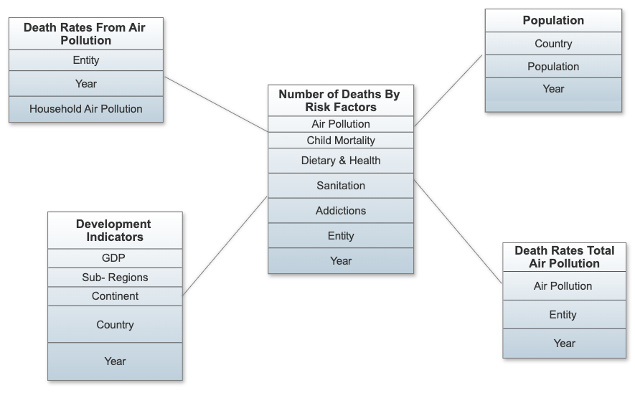
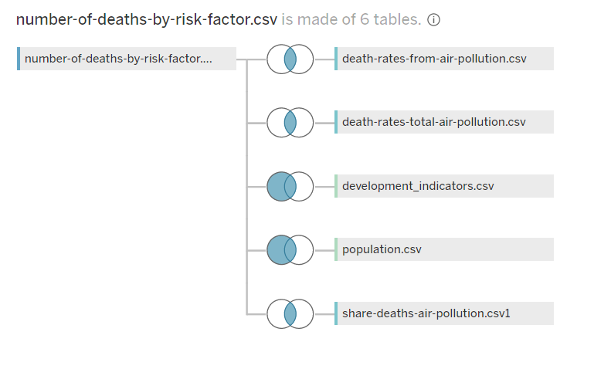
DATASET & METHODOLOGY
The Dataset is taken from the Kaggle which shows that the deaths by various parameters such as Air pollution, child mortality, dietary habits and lifestyle choices
Link : Dataset
ER Diagram
Types of Joins used to combine dataset
Notes:
Dataset plays an essential role in Visualization as the data will determine how the visualization will look like.
For a small dataset, the results may not be able to define all the variables. So, it’s important to choose the dataset which has a large number of values to get meaningful results.
We selected our dataset from kaggle, where five data files from 3 different data sources were used.
Files used:
1. Number of Deaths by risk factors - mentions about
total death cases under various parameters
2. Population - mentions about population wrt
countries and continents
3. Development Indicators - mentions about Years,
Geographical information from Continents, Subregion
and countries attributes, GDP per capita
4. Death rates from air pollution - mentions about
death rates caused to various categories under
pollution
5. Death rate total air pollution- mentions about
overall deaths due to pollution

Slide 6
AIR POLLUTION
OUTDOOR POLLUTION
OZONE POLLUTION
MATTER POLLUTION
HOUSEHOLD POLLUTION
Notes:
Outdoor Pollution: The common sources of outdoor air pollution are emissions caused by combustion processes from motor vehicles, solid fuel burning and industry. Other pollution sources include smoke from bushfires, windblown dust, and biogenic emissions from vegetation (pollen and mould spores).
Ozone Pollution: It is the result of hydrocarbons and nitrogen oxide emissions. It has adverse impacts on human health like Lung function impairment, eye and nose irritation.
Matter Pollution: Particulate matter is everything in the air that is not a gas. Examples of particles which cause this pollution are sulfate, nitrates, ammonia, etc. Sources of particulate matter are construction sites, unpaved roads, fires and smokestacks. As it consist of microscopic solid or liquid droplets as they can be inhaled easily. It can go deep into the lungs or even in the bloodstream.
Household Pollution: It is caused by burning solid fuel sources – such as firewood, crop waste, and dung – for cooking and heating.

Slide 7



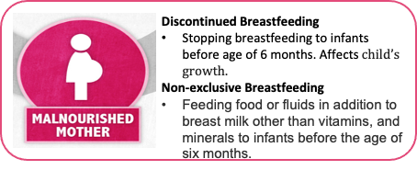
FACTORS LEADING TO CHILD MORTALITY
Child Stunting
Concerning their weight, they have a low height.
Lack of healthcare facilities, poor nutrition, and improper sanitation can impair growth and development
Low-birth weight
New-born babies weighing less than 5 pounds, 8 ounces (2,500 grams)
Causes: Premature birth, lack of oxygen and nutrients to baby in the womb.
Strong indicator of chronic malnutrition
Child Wasting
Low weight for their height
It is a sign that a child has experienced short periods of undernutrition, resulting in significant wastage of muscle and fat tissue.
Notes:
Child Stunting: It means Low height for the child’s weight. It is caused due to poor nutrition, Lack of proper sanitation facilities, etc.
Child wasting: It means low weight for the child’s height. It is observed in children that experience short periods of undernutrition that lead to the reduction in muscle and fat tissue.
Low birth weight: New babies weighing less than 2500 g are considered underweight. It is caused due to the Lack of oxygen and nutrients supplied to the baby when in the mother’s womb. In addition, mothers that are malnourished suffer from chronic kidney diseases and respiratory problems, and are addicted to drugs, alcohol, and smoking give birth to low-weight babies.
Discontinued breastfeeding: It means stopping breastfeeding to infants before the age of six months.
Non-exclusive breastfeeding: Feeding babies less than 6 months of age with fluids and food other than breast milk, prescribed vitamins and
minerals is non-exclusive breastfeeding.
[Discontinued and non-exclusive breastfeeding is usually observed in malnourished mothers who are less than 17 years or older than 35 years of age. Infants not fed exclusively face health problems such as acute respiratory diseases, diarrhea, etc]

Slide 8
Death Cases due to Dietary Habit & Health Issues
Under Poor Dietary Habits
Factors | Optimal Level of Intake
Diet-High in Sodium | 3 g (1–5) per day
Diet Low in Fruits and Nut & Seeds | 250 g (200–300) per day & 125 g (100–150) per day
Diet Low in Vegetables | 360 g (290–430) per day
Diet Low in Wholegrain | 125 g (100–150) per day
Under Health Issues
Factors | Leading Causes
High Blood Pressure & High Cholesterol | Due to diet high in salt, fat, and/or cholesterol; chronic conditions etc
High Plasma Glucose | Due to stress, lack of exercise, eating junk food
High BMI & Low Physical Activity | Due to diet, lack of exercise, stress
Low Bone Mineral Density | Due to smoking, alcohol, age, poor diet, medications
Notes:
Dietary Habit
Research Paper titled “Health effects of dietary risks in 195 countries, 1990–2017” studied the causes of death due to dietary habits. Following are the factors responsible for deaths as the optimal level of intake is not adequate:
• Diet-High in Sodium
• Diet Low in Fruits and Nut & Seeds
• Diet Low in Vegetables
• Diet Low in Wholegrain
• Vitamin- A Deficiency
• Iron Deficiency
The optimal level of intake for each factor is the level of risk exposure that minimizes the risk from all causes of death.
Health Issues
Research paper titled “Combined Effect of Blood Pressure and Total Cholesterol Levels on Long- Term Risks of Subtypes of Cardiovascular Death” studied the causes of death due to Health issues. Following are the factors responsible for death due to health issues:
• High Blood Pressure
• High Cholesterol
• High Plasma Glucose
• High BMI & Low Physical Activity
• Low Bone Mineral Density

Slide 9
Unsafe Sanitation and Water Source
Increased Diseases - cholera, diarrhea etc.
Low-Income countries affected the most
Nearly half of the world do not have access to safe sanitation = WHO
Approximately 775,000 deaths each year - WHO
Notes:
-Unsafe Sanitation and poor water-source can have far-reaching and ill-fated effects who uses the unsanitary toilets facilities, contaminated water use for cooking, bathing and drinking.
-We can simply open the tap and have unlimited access to clean water. But that is not the case with rest of the world!
-Water-borne pathogens and bacterias are spread through contaminated water, causing diseases like diarrhoea, cholera, typhoid etc

Slide 10
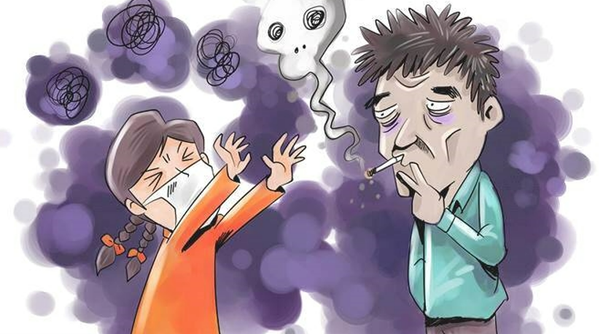

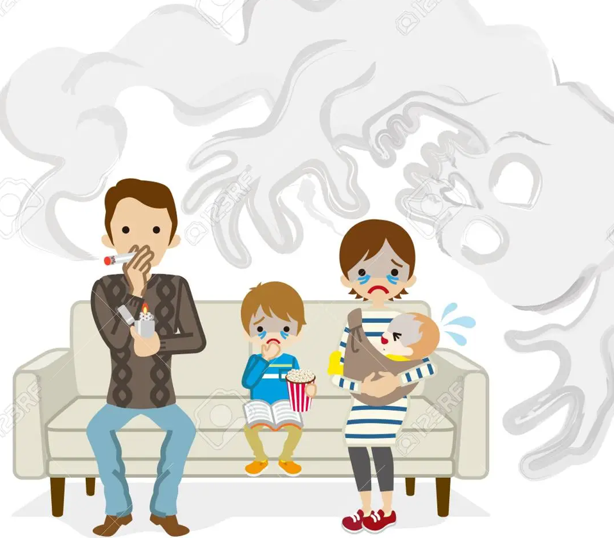

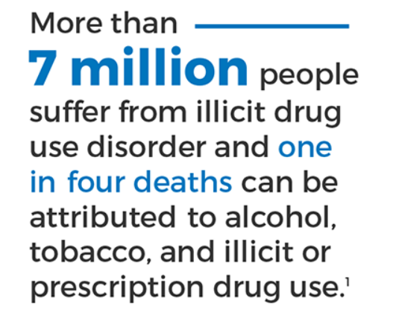
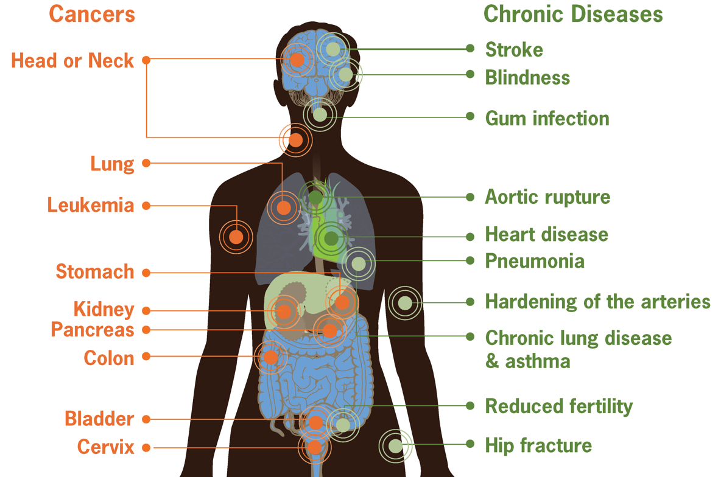
Alcohol, Drugs and Smoking
Notes:
-Substances such as alcohol, marijuana and nicotine also are considered drugs.
- When someone is addicted, he/she may continue using the drug despite the harm it causes.
-Alcohol and tobacco are among the top causes of preventable deaths in the United States.
-Moreover, these substances often are used together: Studies have found that people who smoke are much more likely to drink, and people who drink are much more likely to smoke.
-The effects of these addictions on our body is discussed in [6]. Almost every part of the human body is affected by these addictions.
-Diseases like Cardiovascular, Heart Diseases like stroke, various types of cancers, HIV/AIDS, Lung and Kidney diseases as well as Brain damage are some major ones.
-According to WHO reports , Almost six million people die from tobacco use and 2.5 million from harmful use of alcohol each year worldwide
-Overall statistics of impact of consumption of alcohol, drugs and smoking in the world are further visualized in tableau.

Slide 11
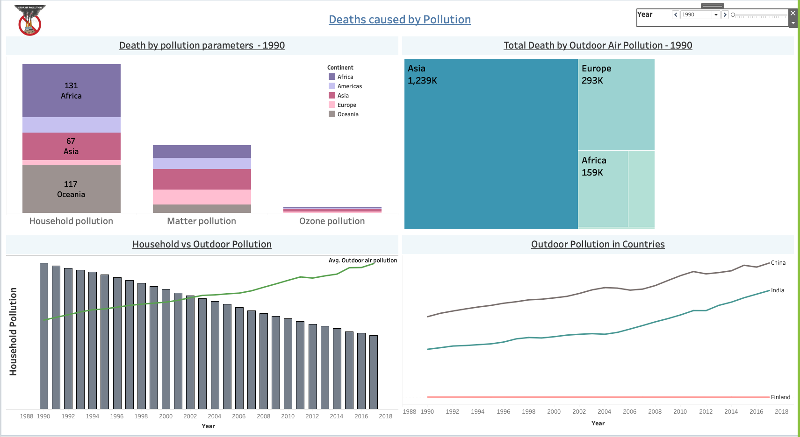
Dashboard 1: AIR POLLUTION

Slide 12
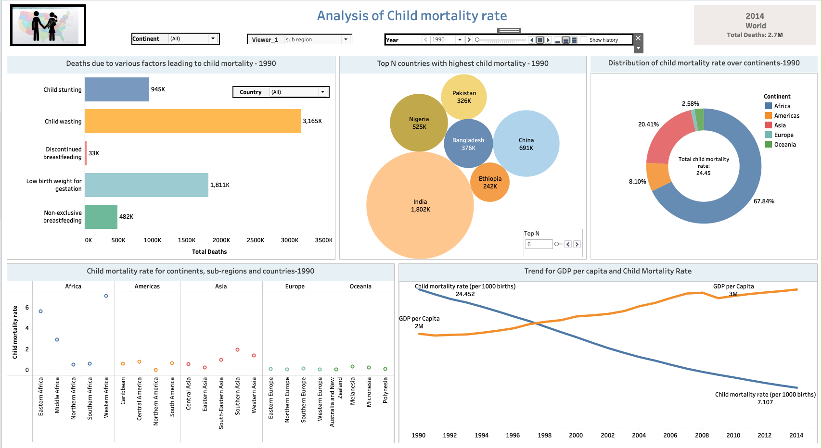
Dashboard 2: Child Mortality

Slide 13
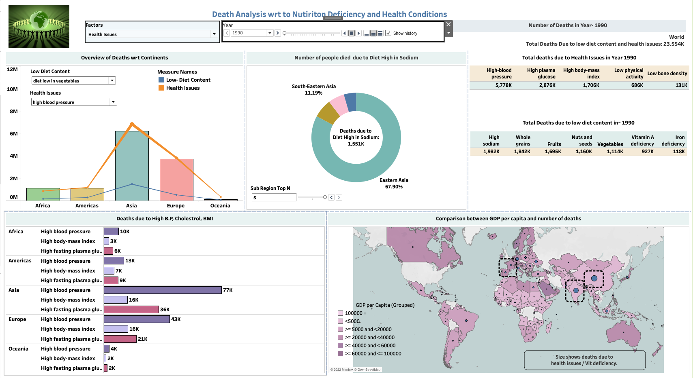
DASHBOARD 3: Lifestyle Choices

Slide 14
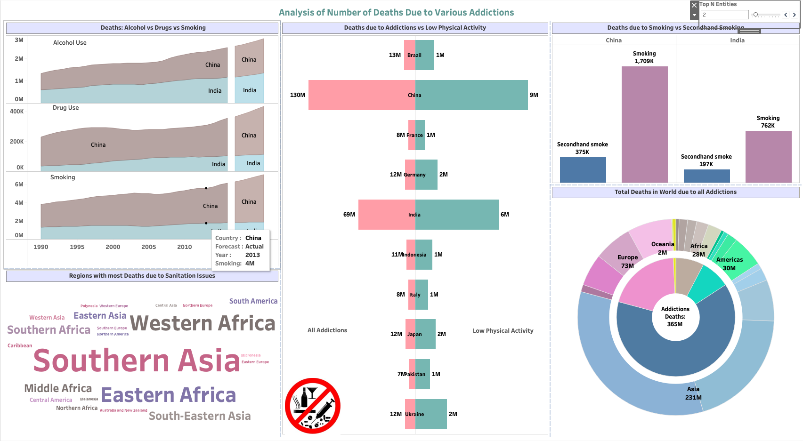
Dashboard 4: Addictions

Slide 15
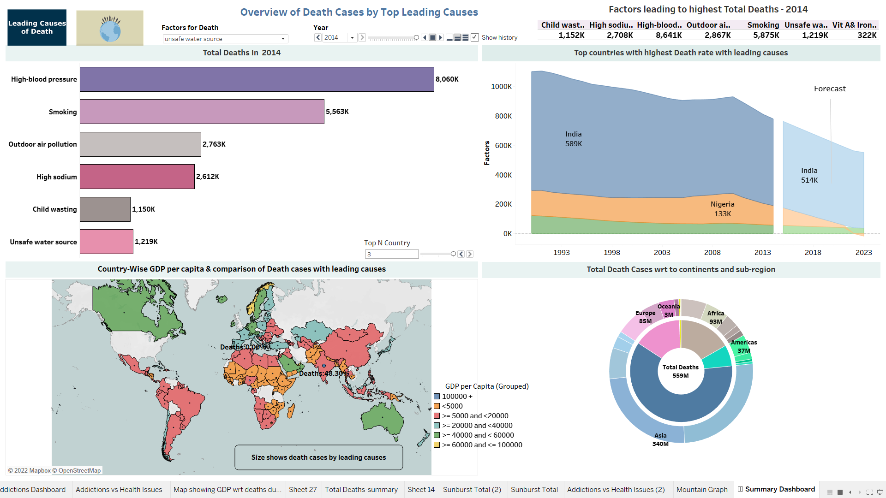
Summary Dashboard

Slide 16
INFERENCE
Air pollution - Since 1990, the number of deaths caused by air pollution has continuously increased. As a result, air pollution caused the most deaths on the Asian continent.
Child mortality – Around 20% of global deaths are caused by child mortality. However, the child mortality rate decreased by 70% from 1990 to 2014. It is expected to decline further by 67% by 2030.
Diet low in nutrition- Diets low in nutrition account for approximately 40% of global deaths
Health conditions- About 62% of global deaths were due to health conditions specifically, with deaths from diabetes and high BMI constituting the highest percentages, approximately 19%
Unsafe sanitation – Poor sanitation and unsafe water sources cause 1.4% of global deaths. In addition, poor sanitary conditions account for 5% of deaths in low-income countries.
Alcohol, drugs, smoking and secondhand smoking – All addiction-related issues account for 74% of global deaths, including alcohol, drugs, smoking, and secondhand smoke. Since 1990, the number of drug overdose deaths has more than tripled.

Slide 17
THANK YOU

